Slide 1
SENTIMENT BASED PRODUCT REVIEW USING HADOOP
Jayesh Patil, Rutesh Patil, Mansi Somani, Sheel Varma

Slide 2
Abstract
Cell phones have become the most easiest and convenient medium of communication in the modern era.
Sentiment analysis gives us the insight of the good and bad attributes of the cell phone in the current market.
Every cell phone has its own strength like camera having good megapixels or a weakness of having a slow processor.
Giving the best possible ratings of the product’s feature by analysing the comments is the objective.

Slide 3
Sentiment Analysis
The users feeling towards a product is called as a sentiment.
The analysis of such reviews is called sentiment analysis.
Uses natural language processing, text analysis to extract information from the available material.

Slide 4
Product
The product used is a cell phone.
5 cell phones are used as.
Moto G Turbo, Redmi, Lava Iris, Samsung Galaxy Grand 2, Nexus 6p.

Slide 5
Hadoop
It gives faster access to data.
This results in more deep analysis using more data points.
Hadoop is cost effective because of distributed power.
The storage cost is less as a result the organization can keep more storage data.

Slide 6
Penn treebank project acronyms:
Number | Tag | Description
1. | CC | Coordinating conjunction
2. | CD | Cardinal number
3. | DT | Determiner
4. | EX | Existential there
5. | IN | Preposition or subordinating conjunction
6. | JJ | Adjective
7. | JJR | Adjective, comparative
8. | JJS | Adjective, superlative
9. | LS | List item marker
10. | MD | Modal
11. | NN | Noun, singular or mass
12. | NNS | Noun, plural

Slide 7
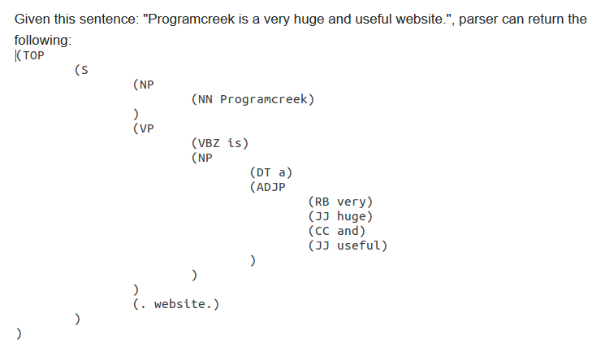
Example

Slide 8
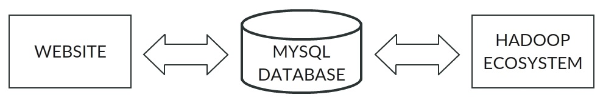
Working

Slide 9
Mapper-Reducer 1 Stopword Removal.java
Mapper 1
Sentences are detected.
Punctuation are removed.
Phrase removal is done.
Finally Stop words are removed.
Feature Category.
Reducer 1
Parts of Speech (POS) tagging is done.
MOTO G, Display, JJ, awesome.

Slide 10
Mapper-Reducer 2 Sentiword Extractor.java
Mapper 2
Values from sentiwordnet.
Eg. MOTO G, Display, JJ , awesome
MOTO G, Display, JJ , 0.86
Reducer 2
Reducer will aggregate values obtained from the mapper class.
MOTO G, Display, JJ , 0.67

Slide 11
Functions
Detecting sentences from the comments.
Removing punctuation, phrases and stop words from the comments.
Determining which product feature the user is addressing in the comment.
Identifying Parts of speech for every word.

Slide 12
Determining polarity of certain words.
Assigning values to ever word.
Calculating final value for each word.

Slide 13
Sentence Detection
Steps | Output in Key – Value Pair
Input | MOTO_G<tab separator>The display quality of the “phone” is fantastic and awesome. The music ratio of the phone….could have been better. While on the ‘other hand’ the battery is not so good.
Sentence Detection | MOTO_G<tab separator>The display quality of the “phone” is fantastic and awesome. MOTO_G<tab separator>The music ratio of the phone….could have been better. MOTO_G<tab separator>While on the ‘other hand’ the battery is not so good.

Slide 14
Punctuation Removal
Steps | Output in Key – Value Pair
Sentence Detection | MOTO_G<tab separator>The display quality of the “phone” is fantastic and awesome. MOTO_G<tab separator>The music ratio of the phone….could have been better. MOTO_G<tab separator>While on the ‘other hand’ the battery is not so good.
Punctuation Removal | MOTO_G<tab separator>the display quality of the phone is fantastic and awesome MOTO_G<tab separator>the music ratio of the phone could have been better MOTO_G<tab separator>while on the other hand the battery is not so good

Slide 15
Phrase Removal
Steps | Output in Key – Value Pair
Punctuation Removal | MOTO_G<tab separator>the display quality of the phone is fantastic and awesome MOTO_G<tab separator>the music ratio of the phone could have been better MOTO_G<tab separator>while on the other hand the battery is not so good
Phrase Removal | MOTO_G<tab separator>the display quality of the phone is fantastic and awesome MOTO_G<tab separator>the music ratio of the phone not better MOTO_G<tab separator>while on the other hand the battery is not so good

Slide 16
Stop Words Removal
Steps | Output in Key – Value Pair
Phrase Removal | MOTO_G<tab separator>the display quality of the phone is fantastic and awesome MOTO_G<tab separator>the music ratio of the phone not better MOTO_G<tab separator>while on the other hand the battery is not so good
Stop Words Removal | MOTO_G<tab separator>display quality phone fantastic awesome MOTO_G<tab separator>music ratio phone not better MOTO_G<tab separator>hand battery not good

Slide 17
Feature Category
Steps | Output in Key – Value Pair
Stop Words Removal | MOTO_G<tab separator>display quality phone fantastic awesome MOTO_G<tab separator>music ratio phone not better MOTO_G<tab separator>hand battery not good
Feature Category | MOTO_G,DISPLAY<tab separator>display quality phone fantastic awesome MOTO_G,SOUND<tab separator>music ratio phone not better MOTO_G,BATTERY<tab separator>hand battery not good

Slide 18
Parts-Of-Speech Tagging
Steps | Output in Key – Value Pair
Feature Category | MOTO_G,DISPLAY<tab separator>display quality phone fantastic awesome MOTO_G,SOUND<tab separator>music ratio phone not better MOTO_G,BATTERY<tab separator>hand battery not good
Parts-Of-Speech Tagging | MOTO_G,DISPLAY<tab separator>NN,display NN,quality NN,phone JJ,fantastic JJ,awesome MOTO_G,SOUND<tab separator>NN,music NN,ratio NN,phone RB,not RB,better MOTO_G,BATTERY<tab separator>NN,hand NN,battery RB,not JJ,good

Slide 19
Words Classifier
Steps | Output in Key – Value Pair
Parts-Of-Speech Tagging | MOTO_G,DISPLAY<tab separator>NN,display NN,quality NN,phone JJ,fantastic JJ,awesome MOTO_G,SOUND<tab separator>NN,music NN,ratio NN,phone RB,not RB,better MOTO_G,BATTERY<tab separator>NN,hand NN,battery RB,not JJ,good
Words Classifier | MOTO_G,DISPLAY,ADJECTIVE<tab separator>fantastic, awesome MOTO_G,SOUND,NEGATIVEADJECTIVE<tab separator>better MOTO_G,BATTERY,NEGATIVEADJECTIVE<tab separator>good

Slide 20
SentiWordNet Values
Steps | Output in Key – Value Pair
Words Classifier | MOTO_G,DISPLAY,ADJECTIVE<tab separator>fantastic, awesome MOTO_G,SOUND,NEGATIVEADJECTIVE<tab separator>better MOTO_G,BATTERY,NEGATIVEADJECTIVE<tab separator>good
SentiWordNet Values | MOTO_G,DISPLAY,ADJECTIVE<tab separator> 0.241, 0.25 MOTO_G,SOUND,NEGATIVEADJECTIVE<tab separator> -0.416 MOTO_G,BATTERY,NEGATIVEADJECTIVE<tab separator> -0.25

Slide 21
Calculate Overall Value
Steps | Output in Key – Value Pair
SentiWordNet Values | MOTO_G,DISPLAY,ADJECTIVE<tab separator> 0.241, 0.25 MOTO_G,SOUND,NEGATIVEADJECTIVE<tab separator> -0.416 MOTO_G,BATTERY,NEGATIVEADJECTIVE<tab separator> -0.25
Calculate Overall Value | MOTO_G,DISPLAY<tab separator> 0.2455 MOTO_G,SOUND<tab separator> -0.416 MOTO_G,BATTERY<tab separator> -0.25

Slide 22
References
Micropinion Generation:
An Unsupervised Approach To Generating Ultra-Concise Summaries Of Opinions [1]
A semantic approach for text clustering using WordNet and lexicalChains [2]
Cross-Domain Sentiment Classification via Spectral Feature Alignment [3]
Analysis of Big data using Apache Hadoop and Map Reduce [4]
A High Accuracy Method for Semi-Supervised Information Extraction Clustering algorithms [5]

Slide 23
Thank You

